Slide 1
Speeding up
Generalized Fuzzy k-Means Clustering
Using m Nearest Cluster Centers
Algorithm on GPU
Student：Dinh-Trung Vu
Advisor：Prof. Zone-Chang Lai

Slide 2
OUTLINE
Introduction
Parallel GFKM model
Updating membership step
Calculating new centroids step
Checking convergence step
Experimental results
Conclusion and Future work

Slide 3
INTRODUCTION
GFKM : less computing time, better clustering quality than FKM.
Optimal value of M is 2 → better clustering results.
Size, dimensionality of data set grow
→ running time of GFKM grows.
Focus on the size of data set.
Parallel GFKM: 3 to 18 times faster than on CPU.
Notes:
Average speedup is about seven to ten times

Slide 4
OUTLINE
Introduction
Parallel GFKM model
Updating membership step
Calculating new centroids step
Checking convergence step
Experimental results
Conclusion and Future work

Slide 5
Parallel GFKM Model
CPU
GPU
Initialize Centroids
Update Membership
Small data set
Calculate new Centroids
Large data set
Calculate new Centroids
Left small data blocks
No
Check Convergence
Results
Yes

Slide 6
OUTLINE
Introduction
Parallel GFKM model
Updating membership step
Calculating new centroids step
Checking convergence step
Experimental results
Conclusion and Future work

Slide 7
Updating membership on CPU
DNNT : M nearest distances responding to NNT_{i}
For each data point X_{i}
Two levels of loop
For each centroid C_{j}
Update membership for data point X_{i}
Calculate distance d(X_{i}, C_{j})
Update NNT_{i} and DNNT

Slide 8
Updating membership on GPU
N threads in parallel → one level of loop
Each thread:
  loads a data point → on-chip registers
  reads same centroids in shared memory:
  writes < 5 values → shared memory, else
  reads same centroids in global memory.

Slide 9
OUTLINE
Introduction
Parallel GFKM model
Updating membership step
Calculating new centroids step
Checking convergence step
Experimental results
Conclusion and Future work

Slide 10
Calculating new centroids on CPU
Number of data points N is small :
Number of active threads in parallel is small
→ GPU is inefficient → CPU is still used,
The computational complexity : O(NMd + kd).

Slide 11
Calculating new centroids on GPU
N is large, k is close to M : using equation of FKM
The computational complexity : O(Nkd + kd)
Have un-coalesced data access
To achieve coalesced data access, use cuBLAS to :
  transpose data points from N×d to d×N,
  transpose memberships from N×k to k×N.

Slide 12
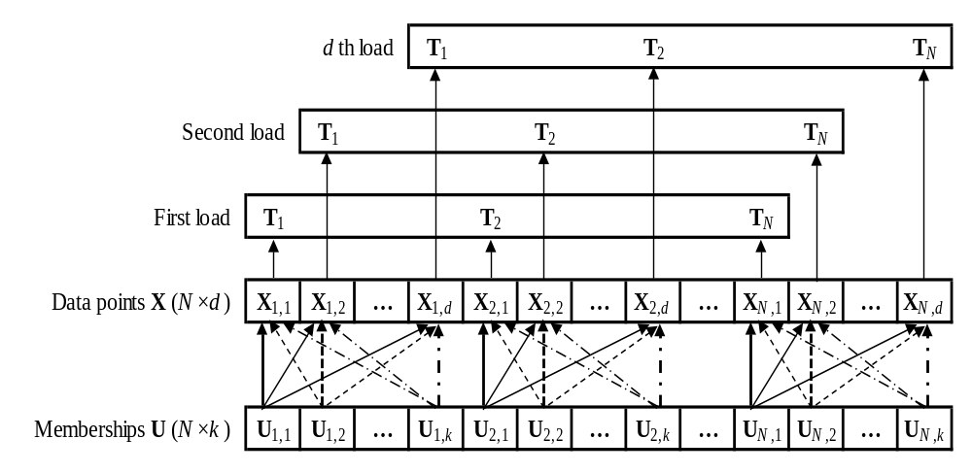
Calculating new centroids on GPU
Un-coalesced data access

Slide 13
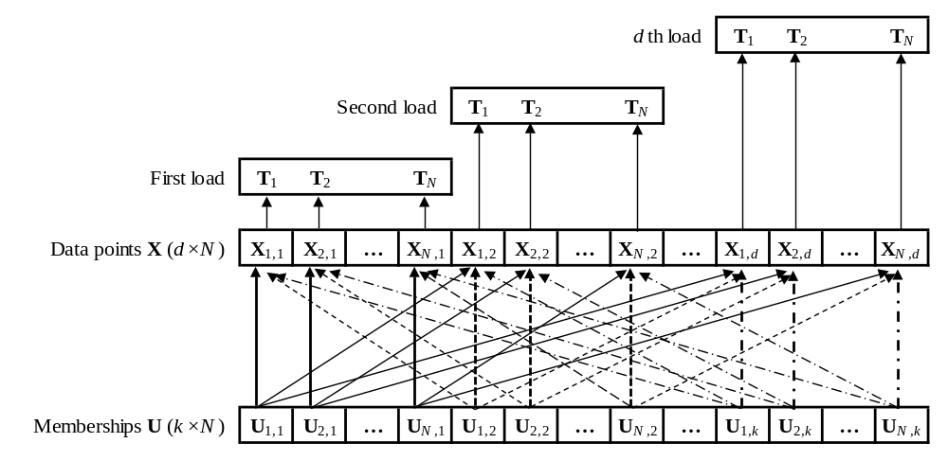
Calculating new centroids on GPU
Coalesced data access

Slide 14
Calculating new centroids on GPU
(1) Reduce U_{i,j}^{q} for jth cluster
(2) Reduce U_{i,j}^{q} * X_{i} for jth cluster & xth dimension
Execute (1) & (2) concurrently or interleaved in different streams
Reduce small output block sums on CPUs.

Slide 15
Calculating new centroids on GPU
N is large, k is not close to M :
Use equation of GFKM.
The computational complexity : O(NMd + kd).
Reduce un-coalesced data accesses :
Transpose data points from N×d to d×N.
Reduce un-coalesced membership accesses : Sort array NNT

Slide 16
Calculating new centroids on GPU
Sort array NNT :
  keys : cluster indices,
  values : point indices, memberships.
Sorting array NNT has two scenarios :
  (1) using GPU-based counting sort algorithm,
  (2) using stable sort by keys of Thrust library.
Scenario (1) : calculate histogram of NNT first.

Slide 17
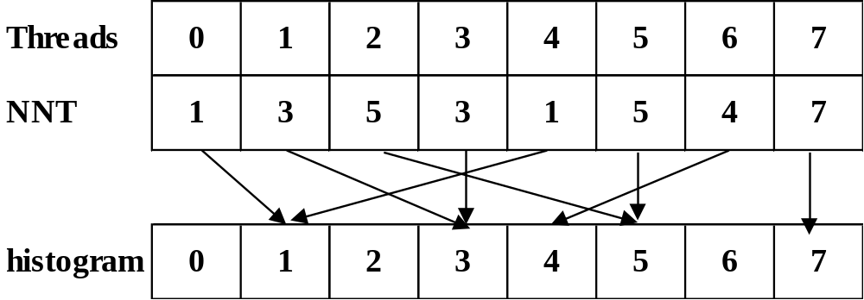
Calculating new centroids on GPU
  Histogram write conflicts : a lots of threads with the same cluster index increase histogram array.

Slide 18
Calculating new centroids on GPU
Counting sort using atomic functions
Calculating histogram of NNT
Thread T_{i}
atomicAdd(histogram(NNT(i)), 1)
Calculating starting index for each cluster
Thread T₀
For i = 1 to k
scan(i + 1) = scan(i) + histo(i)
Thread T_{i}
idx = atomicAdd(scan(NNT(i)), 1)
sortedMemberships(idx) = U(i)
sortedPointIndices(idx) = i/M
Gathering memberships and point indices

Slide 19
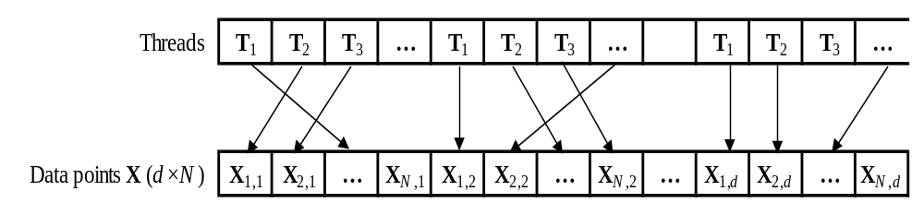
Calculating new centroids on GPU
Counting sort using atomic functions :
Not ensure the stability of point indices in one cluster
Crossover data accesses reduce performance.

Slide 20
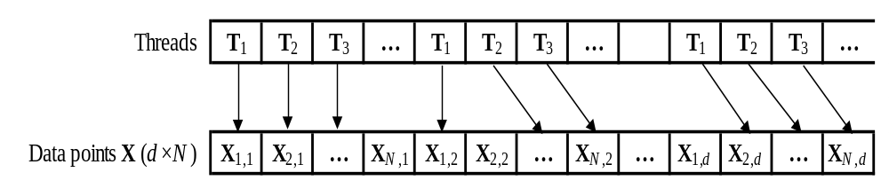
Calculating new centroids on GPU
Un-crossover data accesses :
Use stable sort by keys of Thrust library.

Slide 21
Calculating new centroids on GPU
(1) Reduce U’_{i,l}^{q} for jth cluster.
(2) Reduce U’_{i,l}^{q} * X_{i} for jth cluster & xth dimension.
Execute (1) & (2) concurrently or interleaved in different streams.
Reduce small output block sums on CPUs.

Slide 22
OUTLINE
Introduction
Parallel GFKM model
Updating membership step
Calculating new centroids step
Checking convergence step
Experimental results
Conclusion and Future work

Slide 23
Checking convergence
Occupying a very small quota :
Design on CPU or GPU.
On GPU:
  each thread executes one dimensional of centroid,
  each thread block executes one centroid.

Slide 24
OUTLINE
Introduction
Parallel GFKM model
Updating membership step
Calculating new centroids step
Checking convergence step
Experimental results
Conclusion and Future work

Slide 25
Experimental Results
  CUDA version 7.0 : 64 bit
  NVIDIA GeForce GTX 760 GPU :
    six multi-processors × 192 = 1152 cores,
    0.980 GHz, 2GB, 192.2 GB/s.
  Intel(R) Core(TM) i5-4690 CPU :
    four cores,
    3.5 GHz, 8GB, 25.6 GB/s.

Slide 26
Experimental Results
  Four versions for calculating new centroids step :
    Version 1 : on CPU,
    Version 2 : on GPU using equation of FKM,
    Version 3 : on GPU using counting sort,
    Version 4 : on GPU using Thrust stable sort by key.

Slide 27
Experimental Results
First test : speedup on a real medium data set :
“Lena,” “Baboon,” and “Peppers” with N = 49152, d = 16.
GFKM method M = 2, k = 8, ε = 1e-8 | Speedup of PGFKM
 | Version 1 | Version 2 | Version 3 | Version 4
Updating memberships | 10.5 | 9.95 | 11.38 | 11.41
Calculating new centroids | 1.14 | 1.35 | 1.52 | 0.98
Checking convergence | 1.00 | 1.00 | 1.00 | 1.00
Total after 200 iterations | 6.14 | 6.40 | 7.32 | 5.92

Slide 28
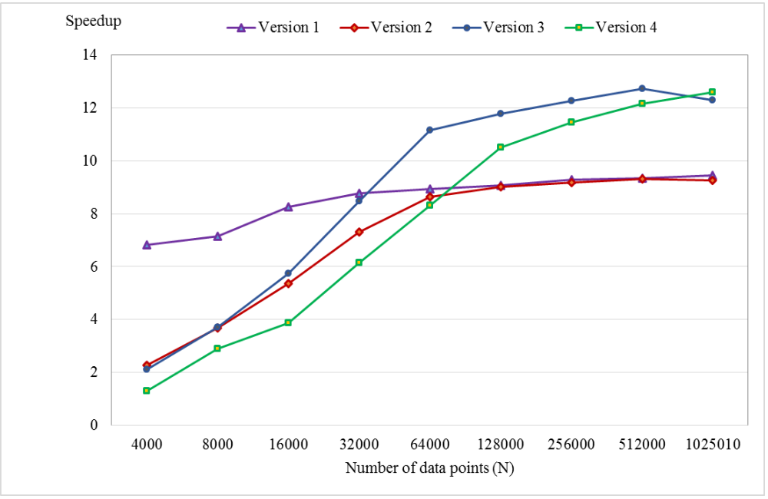
Experimental Results
Second test : changing speedup with various N on “poker” data set with d = 10, M = 2, k = 10, ε = 1e-8, and maximum iterations = 200.

Slide 29
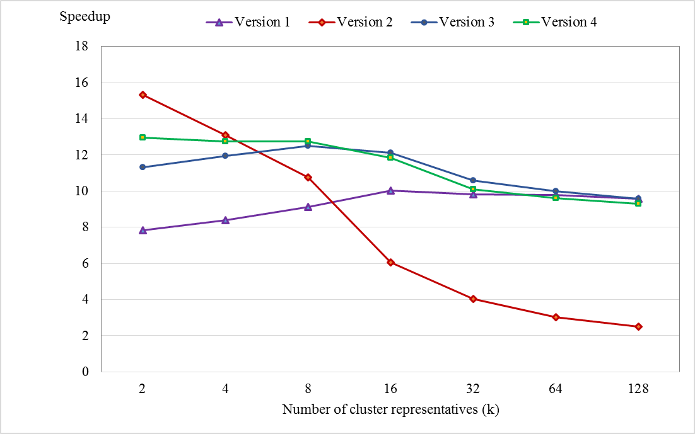
Experimental Results
Third test : changing speedup with various k on “poker” data set with N = 1025100, d = 10, M = 2, ε = 1e-8, maximum iterations = 200.

Slide 30
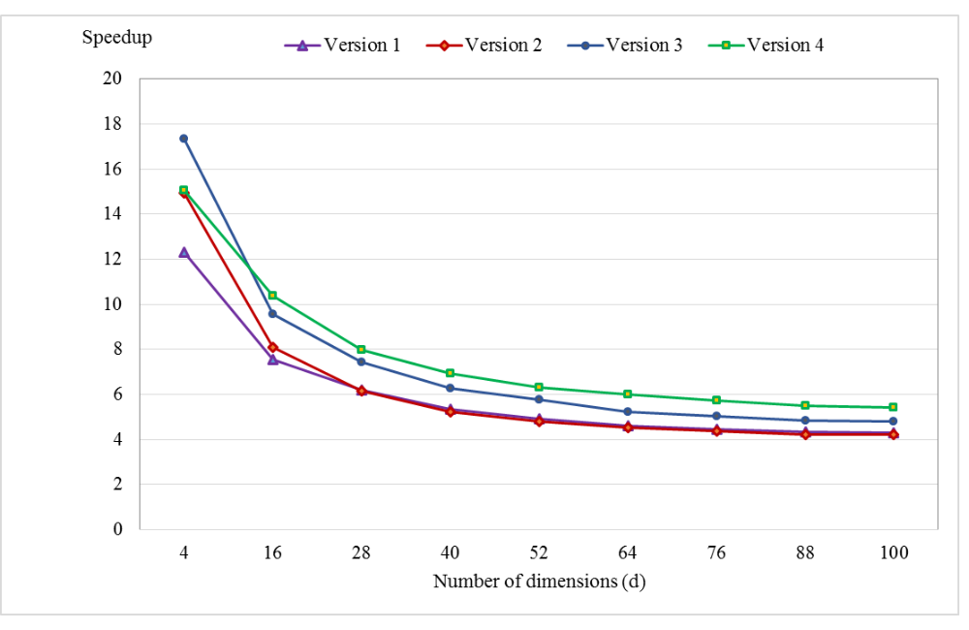
Experimental Results
Fourth test : changing speedup with various d on “Synthetic” data set with N = 491520, M = 2, k = 8, ε = 1e-8, and maximum iterations = 200.

Slide 31
OUTLINE
Introduction
Parallel GFKM model
Updating membership step
Calculating new centroids step
Checking convergence step
Experimental results
Conclusion and Future work

Slide 32
CONCLUSION AND FUTURE WORK
The better speedups : larger N, smaller d and k.
High-dimensional : data point cannot be loaded into registers → reduce performance.
In future, calculate temporary distance, store in on-chip registers :
  load the data to shared memory, tile by tile,
  adopt the idea of parallel matrix multiplication.
Notes:
Average speedup is about seven to ten times

Slide 33


Slide 34
Thank You

